Slide 1
Enzyme Experiment Results
Group 6:
Nathan Ketterlinus, Ny’Gia Williams, Dara Oyefusi, Eleyna McNeil

Slide 2
Introduction
Question: How does temperature affect enzyme (trypsin) activity?
Hypothesis: As temperature increases, enzyme activity will increase up until a certain point, until reaching an optimal temperature. As temperature increases past this point, enzyme activity will decrease.
Rationale: At lower temperatures, the substrates will not have enough kinetic energy to reach the enzymes quick enough for optimal rates. At higher temperatures, the enzymes will denature and be unable to facilitate reactions. The “optimal temperature” is then the highest temperature that the enzyme can withstand before denaturing

Slide 3
Methods
Experimental Variable: Temperature
Tested Temperatures: 30° C, 40° C, 50° C
Control Variables: Salinity and pH were controlled at .075M and 8 respectively
Negative Controls: 3 samples with no enzyme: one for each temperature
Replicates: 3 for each temperature

Slide 4
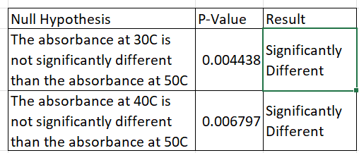
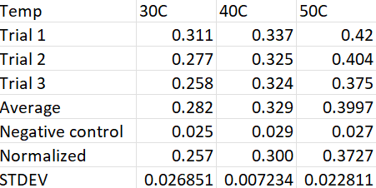
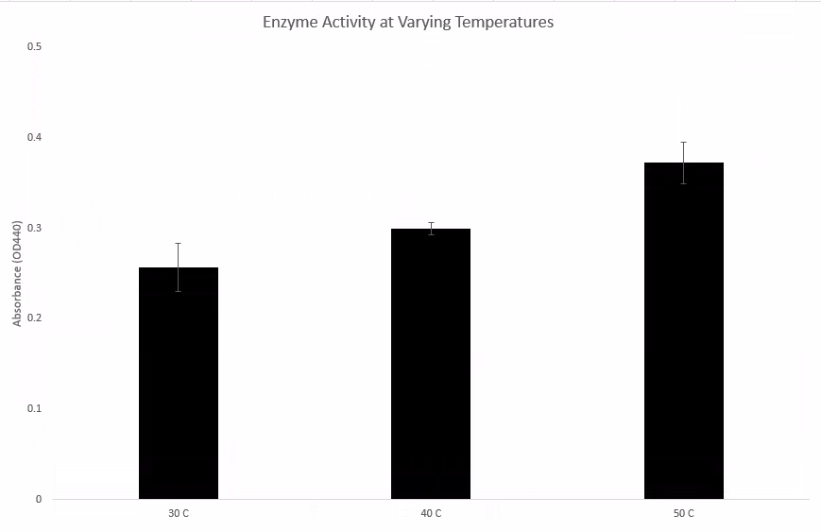
Results
Observation:
When adding TCA the solution clouded and turned a lighter tint of orange

Slide 5
Conclusion / Discussion
Experimental Design: The experimental design was not adequate to test our hypothesis. We did not test temperatures high enough to investigate if activity drops because of high temperatures
Conclusion: Our hypothesis was only half supported by results, Activity only increased as temperatures increased
Changes: When rerunning the experiment, we will use higher temps (and possibly more temps than just 3) to have better granularity over the data.

